Slide 1
Hull Yeah!
Power Management
Working design to add Solar, more battery capacity, and increased charging.

Slide 2
2023 - Excess 14
Excess is a performance cruising brand from the Beneteau Group, differentiating from their Lagoon line of catamarans.
Excess electrical systems are consistent/familiar to other Lagoon/Beneteau configurations.
LOA (Hull) | 13.34m / 44'
LOA w/Davits & Bow Sprit | 16m / 52.5
Beam | 7.87m / 25.82'
Draft | 1.48m / 4' 11"
Air Draft | 21.54 / 70' 8"
Lite Displacement | 12,800 kg (14.1 US Tones) / 28,219.00 lbs
Water Tank | 300L x 1
Black Water | 80L x 2
Engine | Yanmar 57HP
Fuel Tanks | 200L x 2

Slide 3
Hull Yeah! - Specifics
Hull #10 – 3 cabin/owners layout
Purchased March 2025, used from an Excess Dealer in Cyrpus ^{(Easy Sails)}
  Europe 230v model, w/split AC inputs
  Garmin Systems
  Factory options included
    400Ah of Victron Lithium replacing standard AGM
    A few additional Victron components to feed into the Scheiber system
    GenSet and Washing machine – pre-install
Added since our purchase
  Onan 7kw 230v GenSet
  Full Size Washing Machine
  Starlink
  Electric Ninja Oven
  Lumitec SeaBlaze X2 underwater lights, with a POCO controller
Additional Details/Photos of existing systems:
https://sv-hullyeah.blog/hull-yeah-systems/excess-14-factory-energy-systems/

Slide 4
Hull Yeah Sail Plan
Mostly my wife and I, with occasional guests
Sailing the Mediterranean for the next 2-3 years (March – November)
  Docked in Cyprus for the winter – haul out for maintenance, but not stored on the hard
Prefer (98%) to be at anchor, requiring off-grid capabilities
  Marinas only when anchorages not available, or required maintenance
  Water maker (12v/230v Dessalator), genset, electric cooking
Prefer not to run the GenSet, at all, minimizing diesel, noise, pollution, …
Getting LPG is a challenge, so we mostly use our Ninja cooker
  Would like to add a “Hob” cooktop as well, and possibly replace the oven
HVAC – as the Mediterranean is very hot!
  Hull yeah has (3) 230v Wabatso systems
    Port/Starboard - AS10-R-230v
    Saloon - 4FS16-R-230v
  Typically run Saloon and one hull, or both hulls
    When we need full capacity, we can turn on the Genset, but would like to avoid under typical scenarios

Slide 5
Solar Addition
Completing purchase of 2,500w of Solbian Flex panels for the coach roof
  Chose Solbian as they can custom design and be under-mounted, keeping the roof flat
Decided against hard panels
  Want to keep the rear of the boat (davits) open
  Need to keep the roof accessible for maintaining the main sail

Slide 6
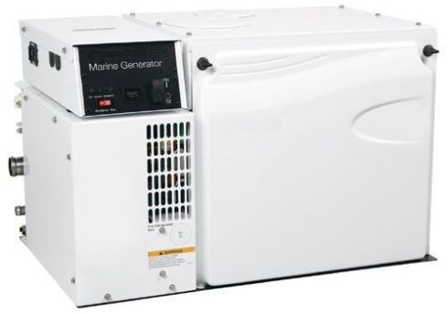

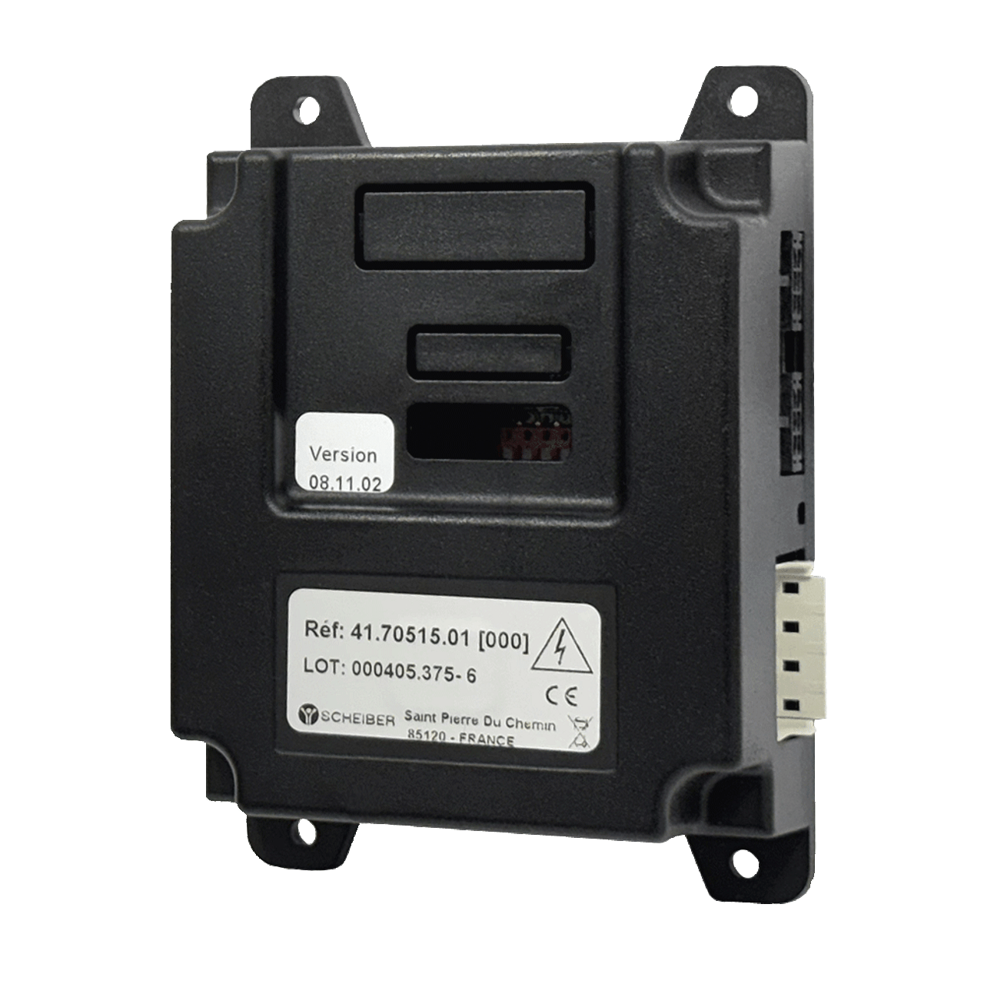
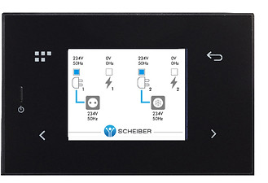
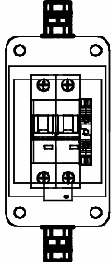
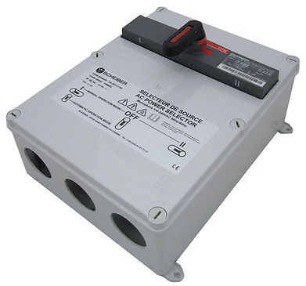
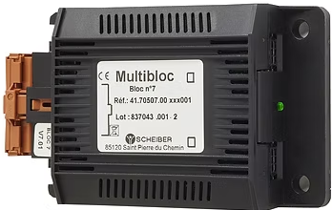

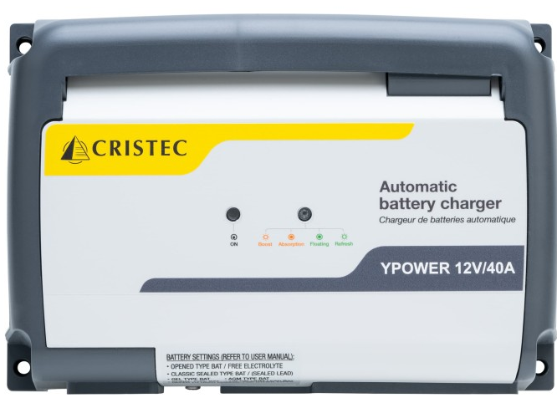

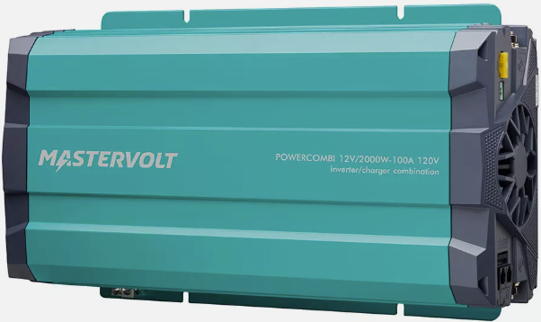
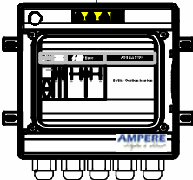
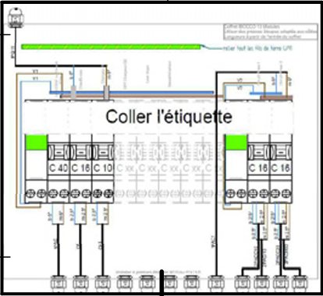
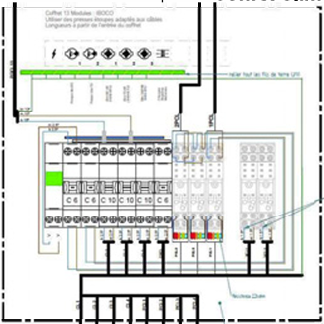
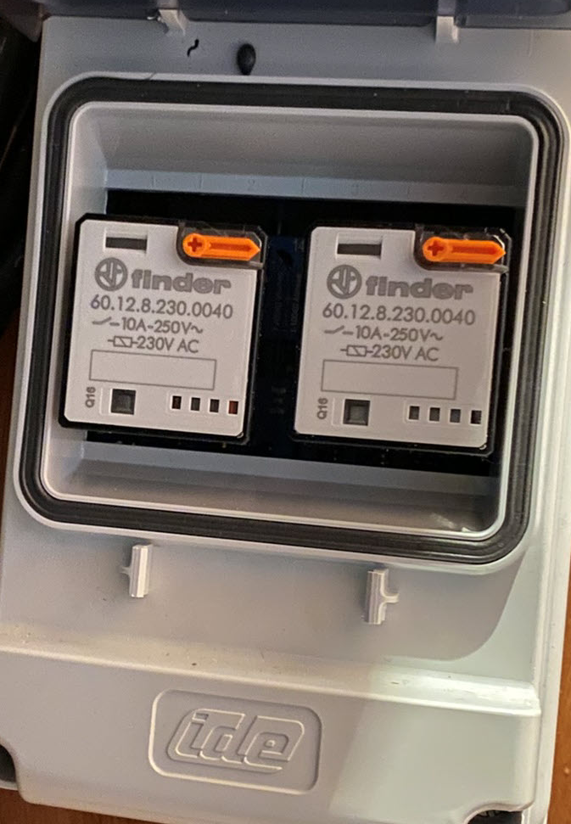
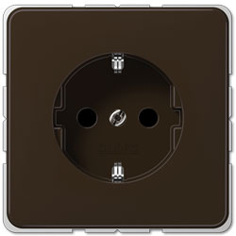
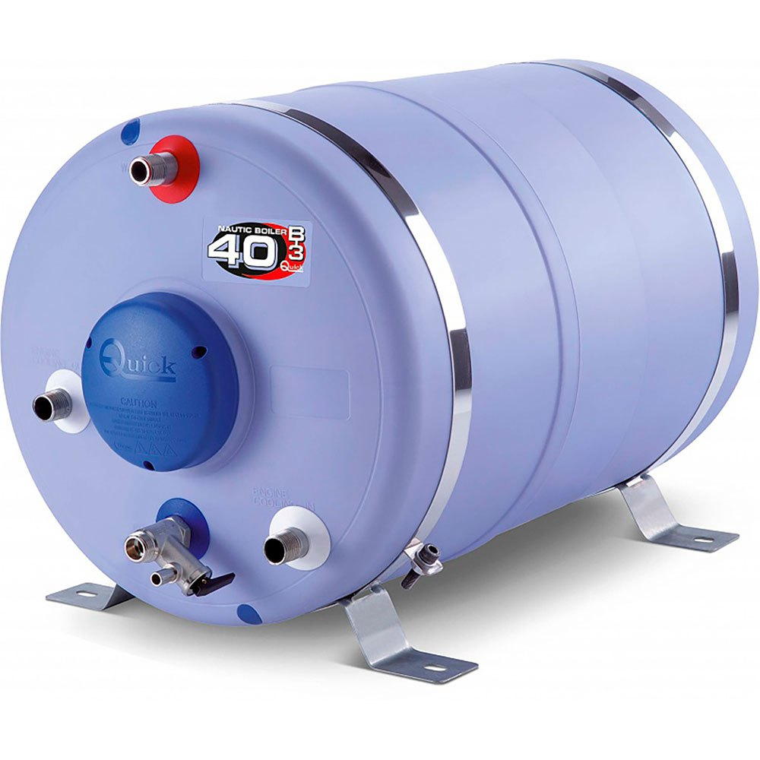
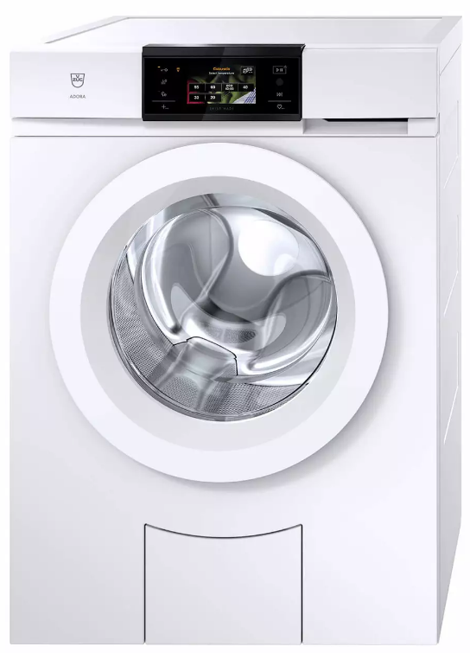
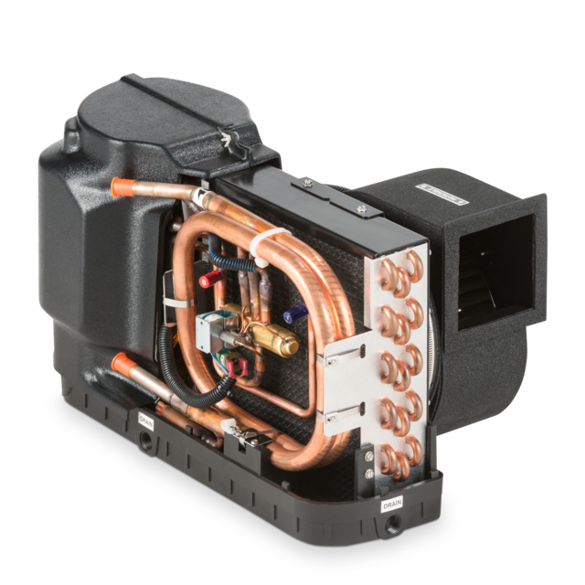

Factory 230v Systems
HVAC
Selector
House
Selector
Inverter
House
Panel
HVAC
Panel
Water Pump
Relays?
V
HVAC Water Pump Port/Saloon
HVAC Port
HVAC Saloon
HVAC Starboard
HVAC Water Pump Starboard

Slide 7
230v Changes
Remove the Scheiber system as it’s:
  Too limited in functionality – no programming of the genset, battery and fluid monitoring too minimal
  Too difficult to configure, with no detailed info when issues come up
  Replaced with Victron Cerbo GX/Touch screen.
    A Cerbo GX already exists to monitor the Victron 200Ah * 2 batteries.
Replace the MasterVolt 2k Inverter with a Victron Quatro 5k
  Will need to patch the hole from the MasterVolt 2k inverter remote at the helm
Prefer to keep the Cristec charger and the existing Victron Batteries as additive 12v supply
Want to support:
  230v Coffee Maker
  230v HOB
  230v Oven – currently using a Ninja 10 in 1 cooker, which has been great
  230v Washing Machine – currently only runs on GenSet
Supported only on shore power/GetSet
  Hot water heater

Slide 8
Factory 230v Systems - Demo
HVAC
Selector
House
Selector
Inverter
House
Panel
HVAC
Panel
Water Pump
Relays?
V
HVAC Water Pump Port/Saloon
HVAC Port
HVAC Saloon
HVAC Starboard
HVAC Water Pump Starboard

Slide 9
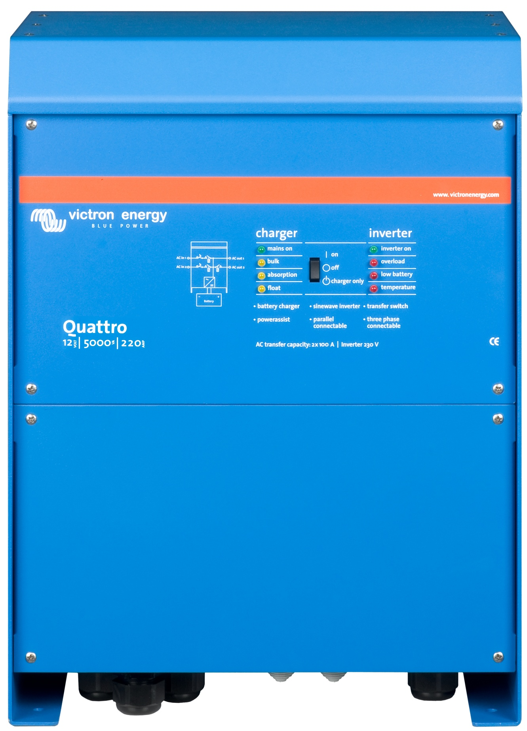
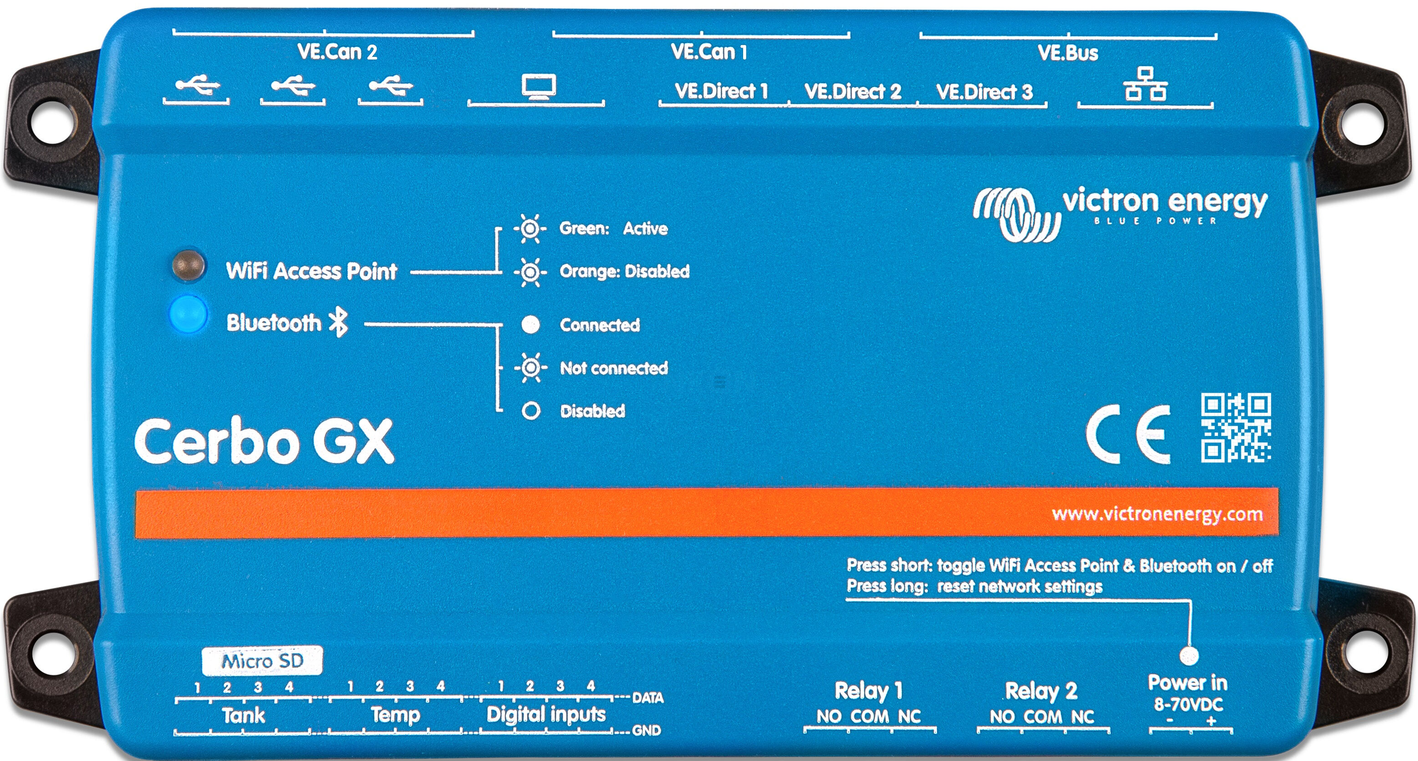
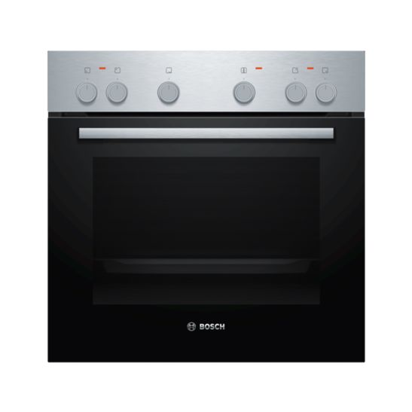
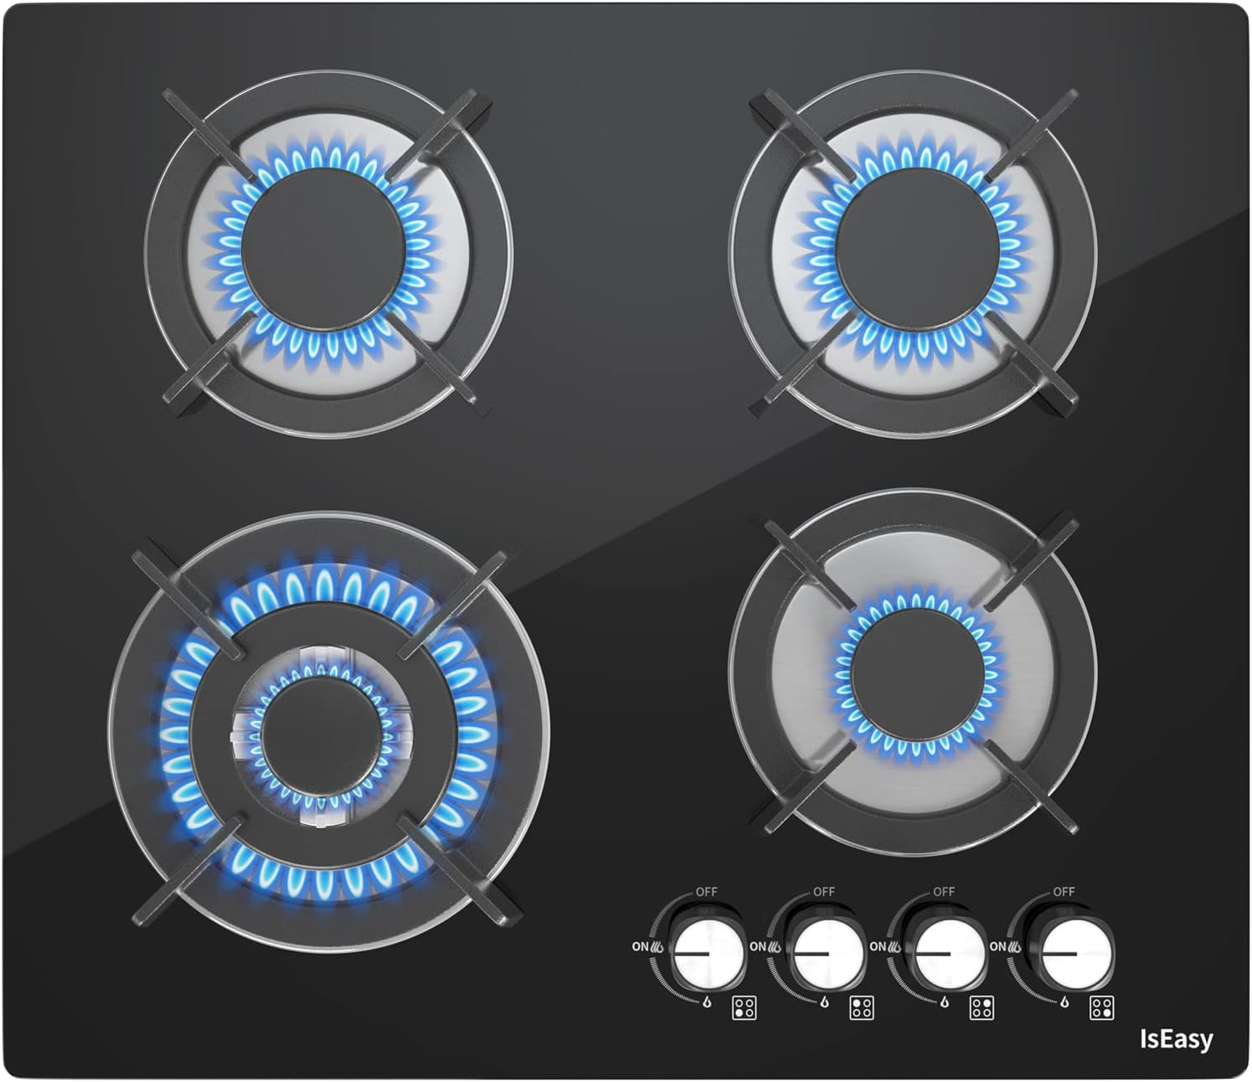
Updated 230v Systems
Start/Stop
Relays
Cerbo GX
Add galvanic isolator
House
Panel
HVAC
Panel
Consider combining 230v Panels
Water Pump
Relays?
HVAC Water Pump Port/Saloon
HVAC Port
HVAC Saloon
HVAC Starboard
HVAC Water Pump Starboard

Slide 10
12v Upgrades
Increase capacity to minimum 1,200ah ^{(4x Victron 300ah NG)}
  Would like to keep existing 12v battery bank and charger 1,200 ^{(new)} + 400 ^{(existing)}
  Possibly use existing 400ah for winches and other 12v systems
Increase charging capacity
  Existing Cristec 60A chargers net 35-40a with normal operation
  Add Victron Quatro 200A charging
  Add ~2,500w solar capacity to the coach roof
Considered 24v and 48v systems, but too complex to make hybrid
  KISS: Keep It Sill Simple

Slide 11
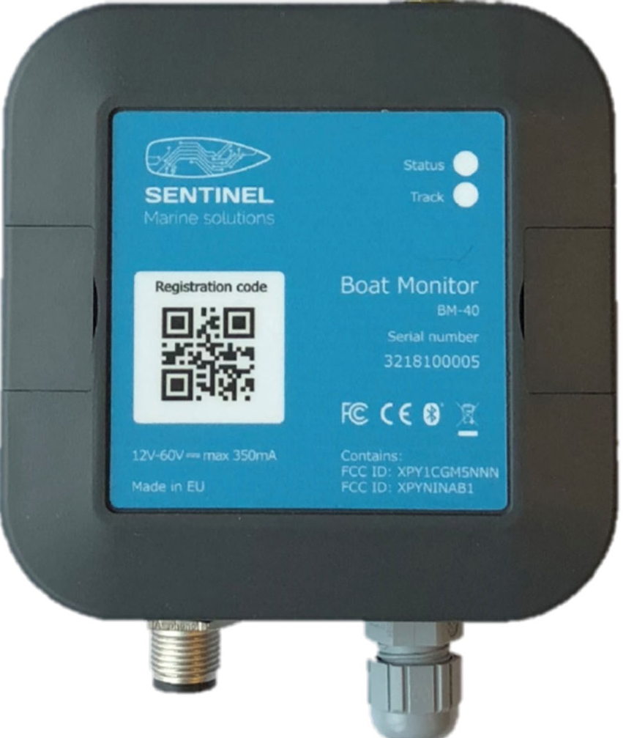


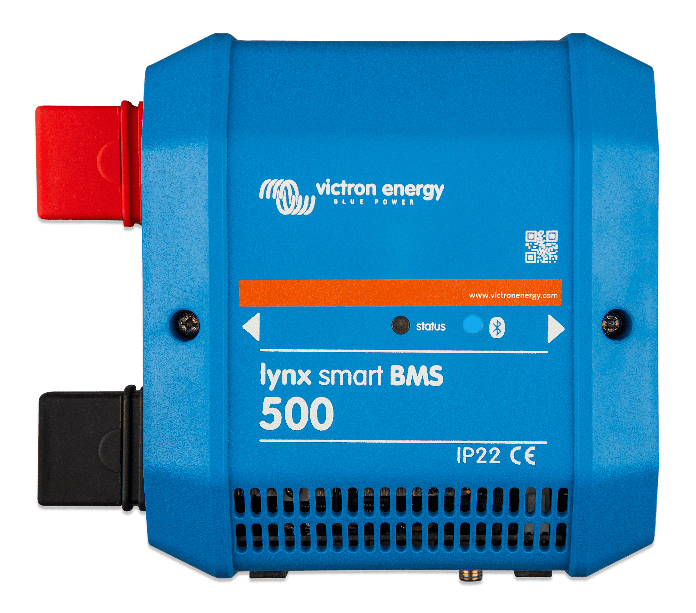
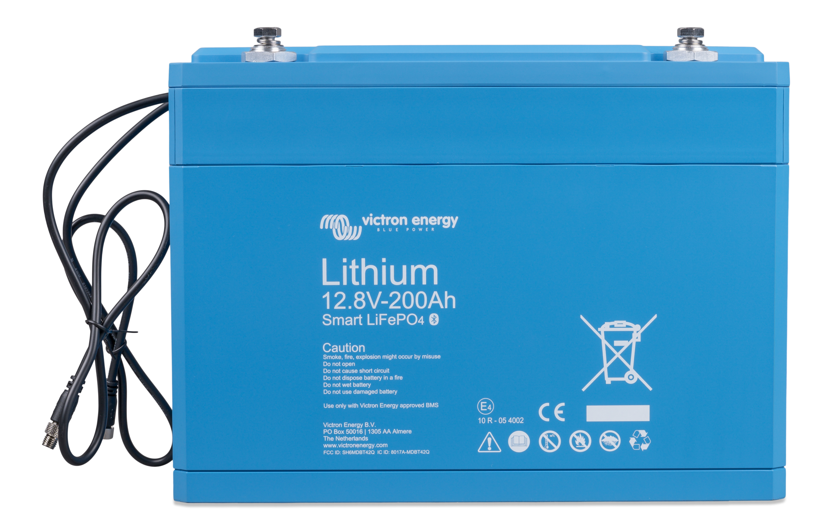
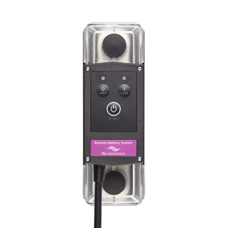
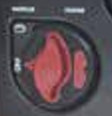
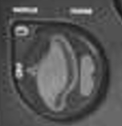
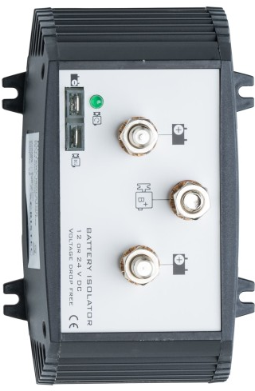
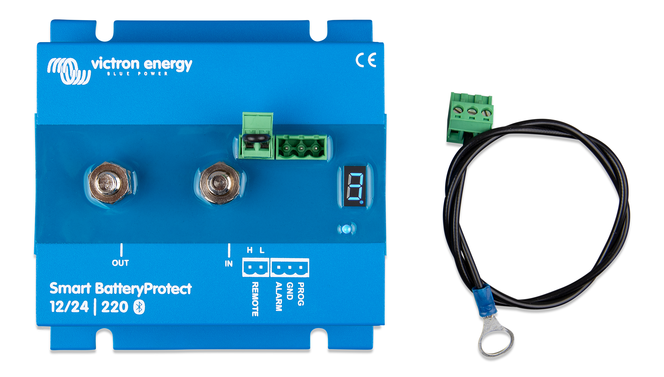
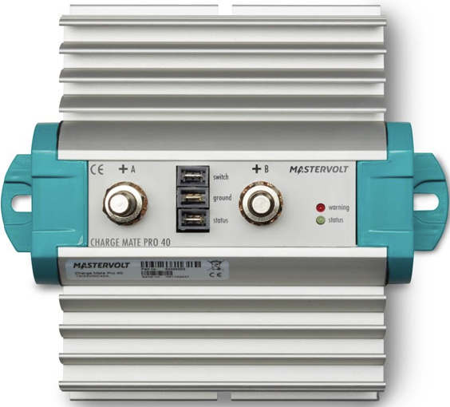


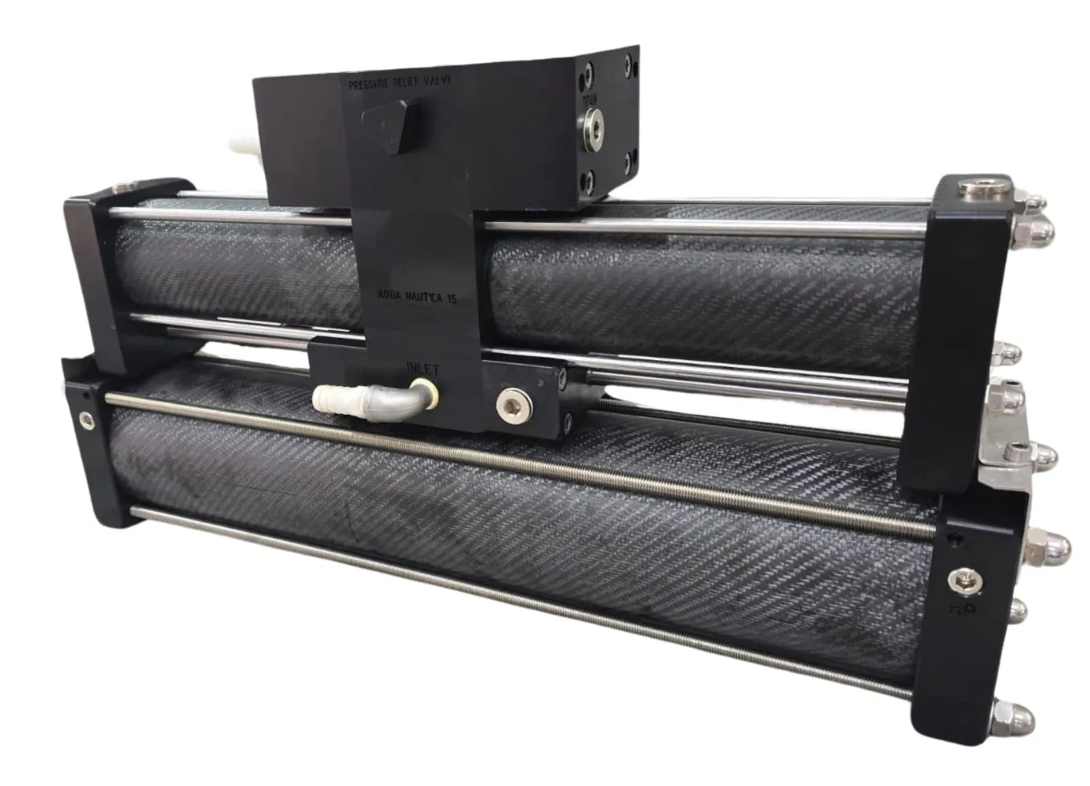
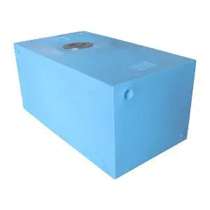
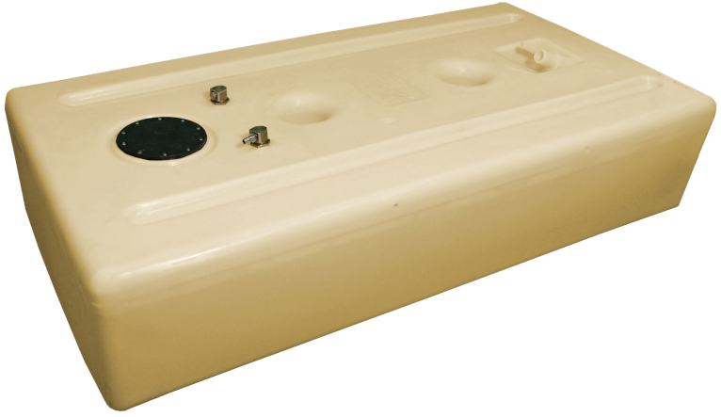
Factory 12v Systems
Start/Stop
Relays
Cerbo GX
Tank/Battery
Sensors
(2) Victron Smart 200Ah
300A
House
AC Bloc
To Charger 1?
To Charger 2?
AC Systems
Haven’t fully traced these configurations
Coupling
Windlass
Winch (Port)
Winch (Starboard)
Water Maker
Fresh Water
Fuel (Port)
Fuel (Starboard)

Slide 12
Factory 12v Systems: Demo
Start/Stop
Relays
Cerbo GX
Tank/Battery
Sensors
(2) Victron Smart 200Ah
300A
House
AC Bloc
To Charger 1?
To Charger 2?
AC Systems
Haven’t fully traced these configurations
Coupling
Windlass
Winch (Port)
Winch (Starboard)
Water Maker
Fresh Water
Fuel (Port)
Fuel (Starboard)

Slide 13
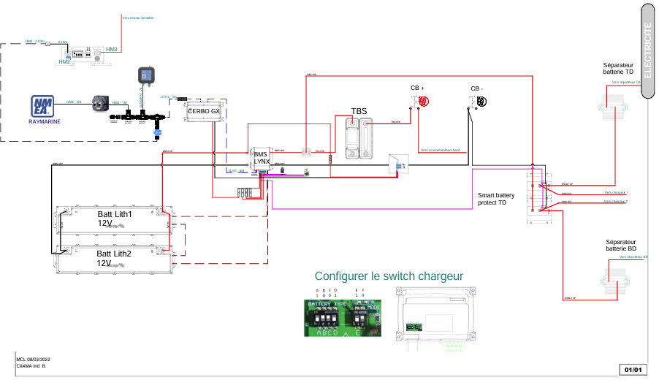
Excess: Factory Lithium Option

Slide 14
Systems Consulting
Proper configurations, amending what exists from the factory
Fusing locations and ratings
Can we “combine” the existing 400ah Victron batteries to the new 1,200ah system
  Would keep existing charging system
  Do we need to split the solar and inverter/charger?
Are there concerns with mixing MasterVolt ChargeMate and Cristec Battery Isolator with Victron, or benefits to justify
Do we need to add DC/DC charging, or use existing Cristec chargers?
Planning – is this the best plan:
  New batteries under guest (port hull) bed – not going to be typically cooled (HVAC), but has reasonable airflow
  Quatro also under the bed, or in the port engine compartment? Heat and noise concerns
  Existing inverter in Port Electrical Cabinet with ~5m cable runs. Is that “reasonable”
I don’t know what I don’t know

Slide 15
Installation
Major challenges finding reliable, reputable vendors
  Language barriers, (it happens when it happens- Siga Siga)
Planning to install myself
  Technical enough to know when to ask for help
  Goal to complete in a few days – adding solar charging/capacity, minimizing season downtime
  Can defer additional changes to November
Having Victron parts & components shipped in from Solbian (Solar)
  Hoping to get power cables locally in Athens

Slide 16
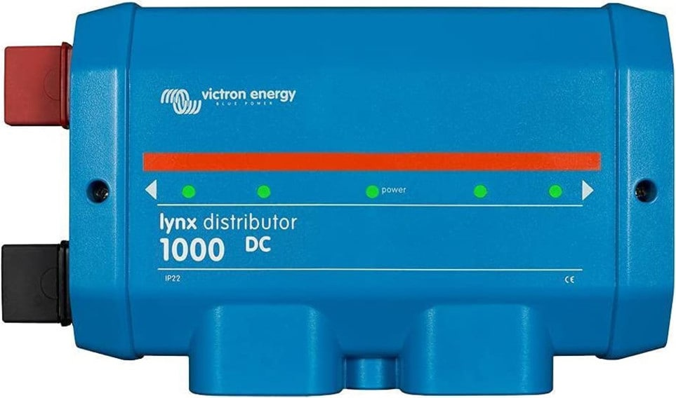
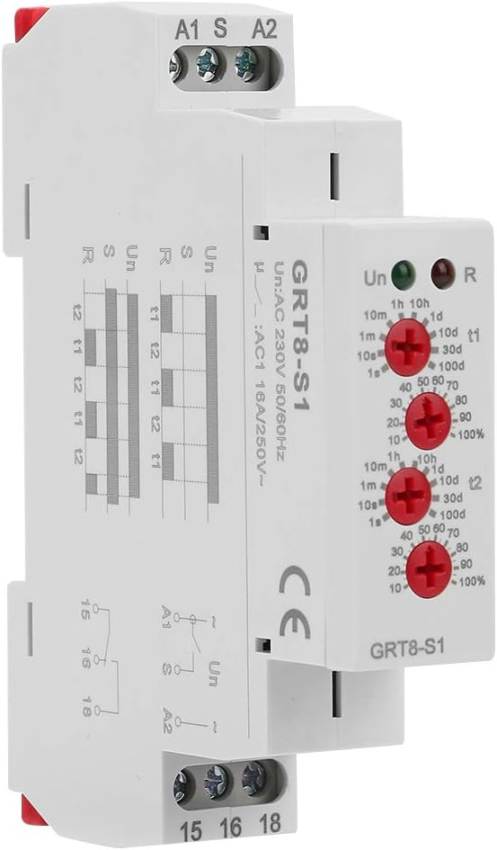
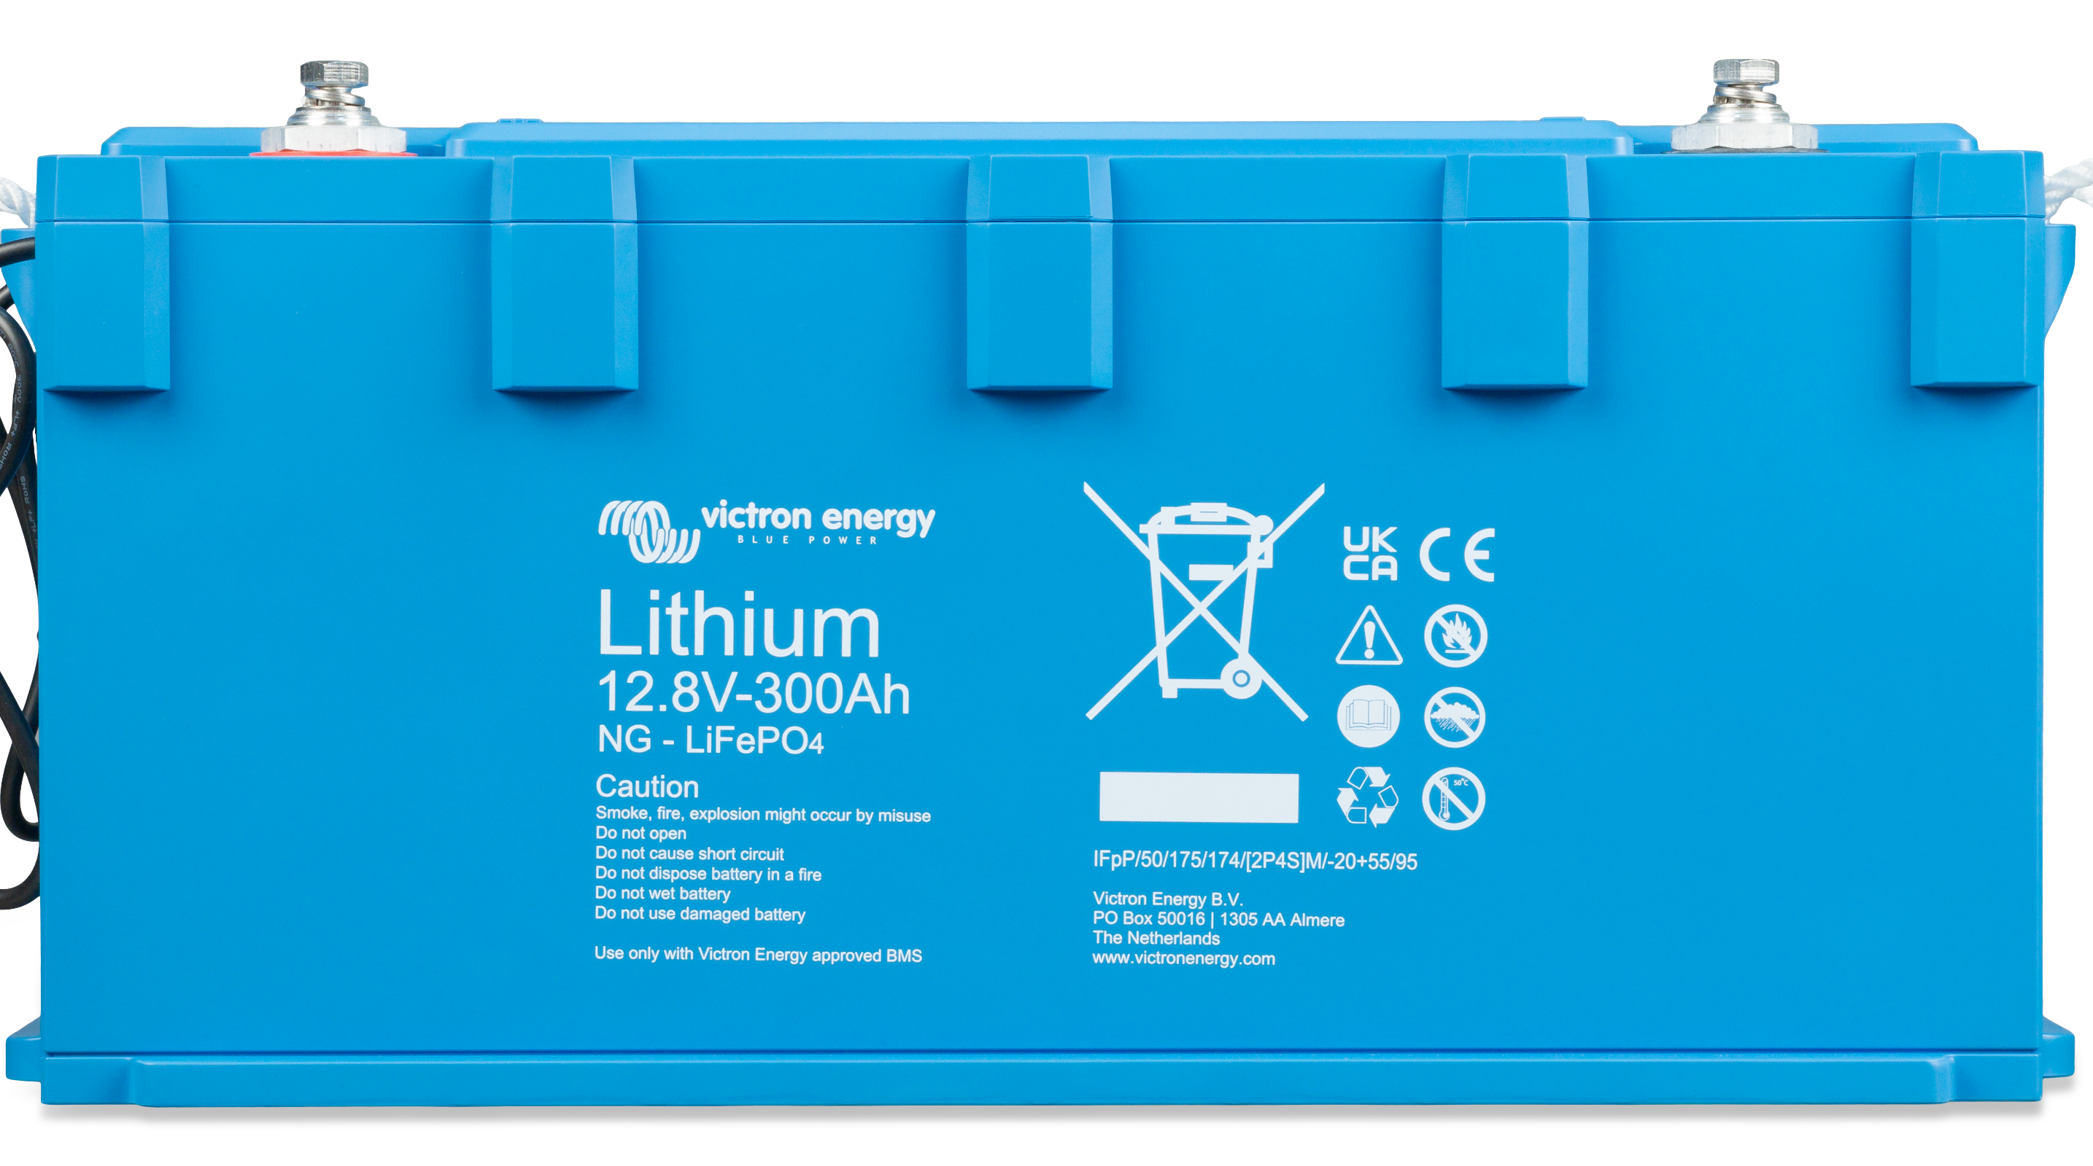
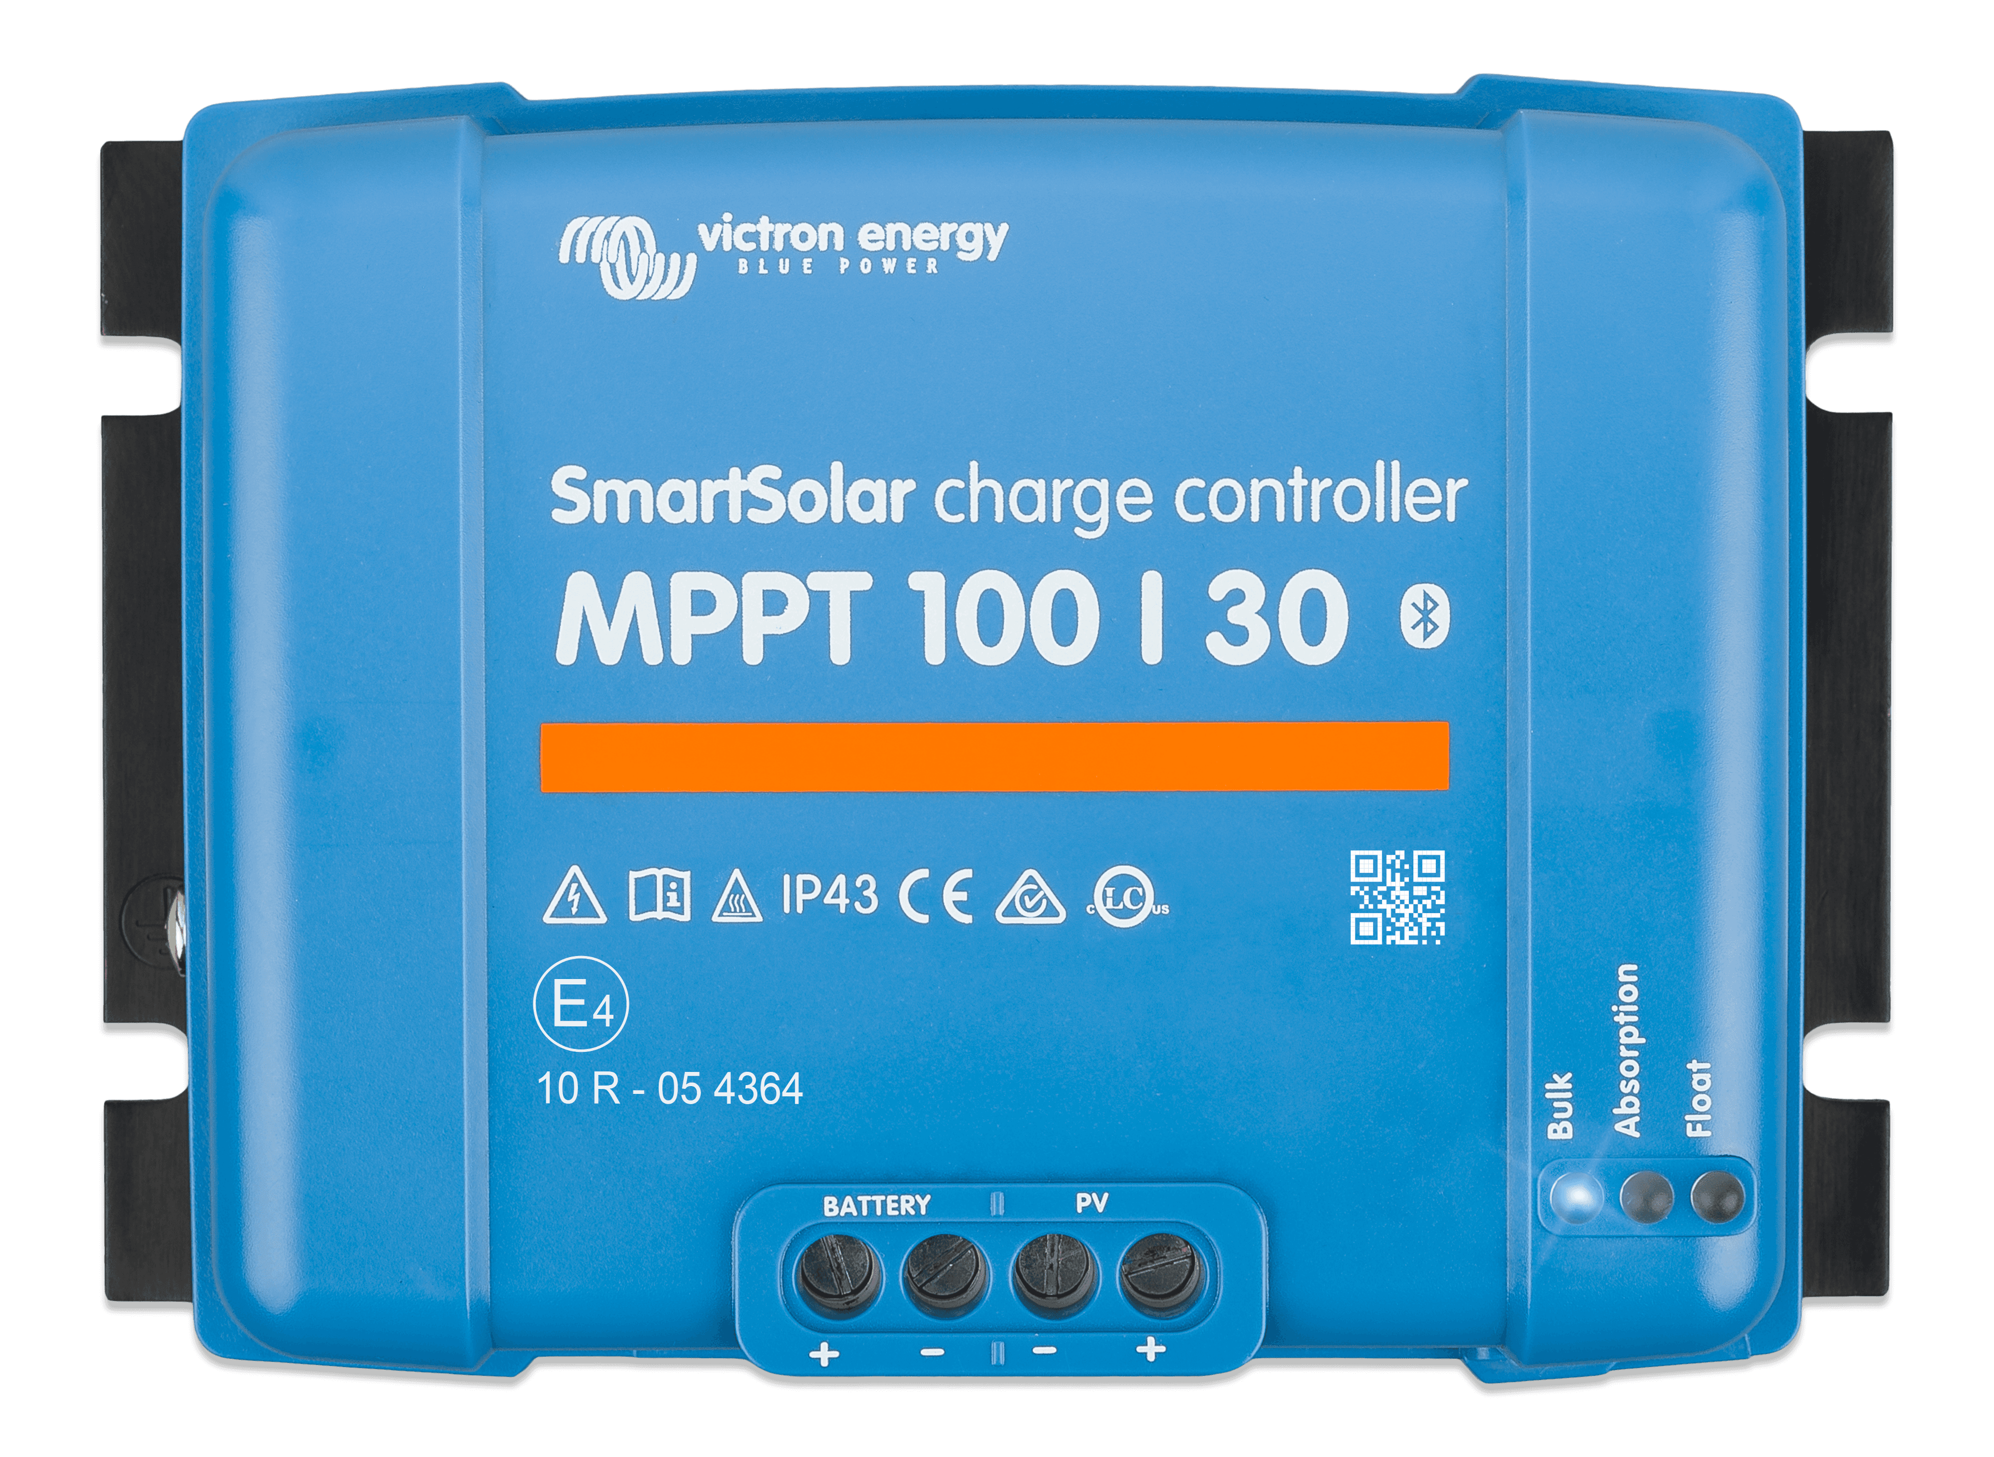
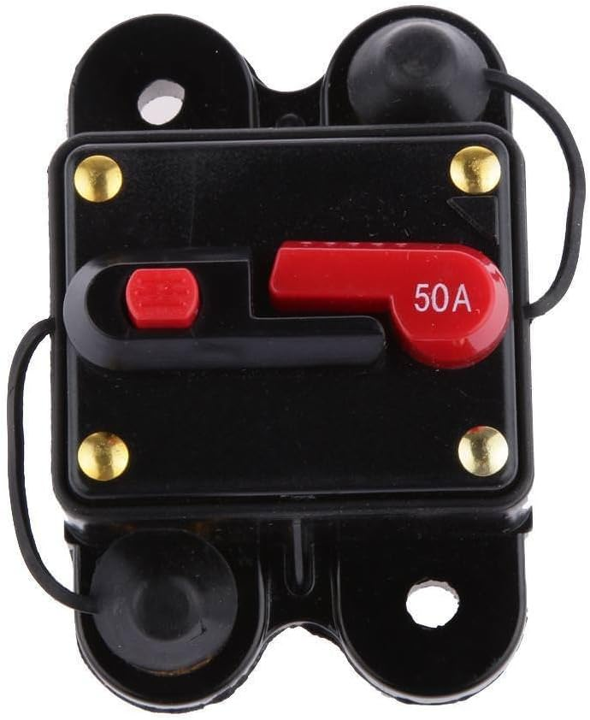
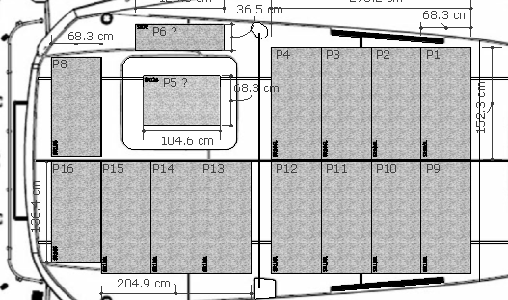
Updated 12v Systems (proposed)
Cristec 60a charger used for engine batteries only
Start/Stop
Relays
750A?
Individual, or dual
Cerbo GX
DC/DC Charging?
300A each
1,200A total
Existing has remote/key battery shutoff
How to do with new?
?A
?
300A?
x2
?
AC/Primary Systems
Existing Cristec RCE/150-1E-2IG
Keep/Replace?
300A
keyed
300A
AC Secondary
Systems
?
House
Existing - no change
HVAC, Washer, Outlets to run from the Inverter
Water Heater, GenSet only
Engine
Coupling
Windlass
Would like to keep existing 12v batteries, and Cristec charger
How to monitor on the Cerbo GX?
Winch (Port)
HVAC Water Pump Starboard
Winch (Starboard)
HVAC Water Pump Port/Saloon
HVAC Port
HVAC Saloon
HVAC Starboard
Water Maker
Fresh Water
Fuel (Port)
Fuel (Starboard)

Slide 17
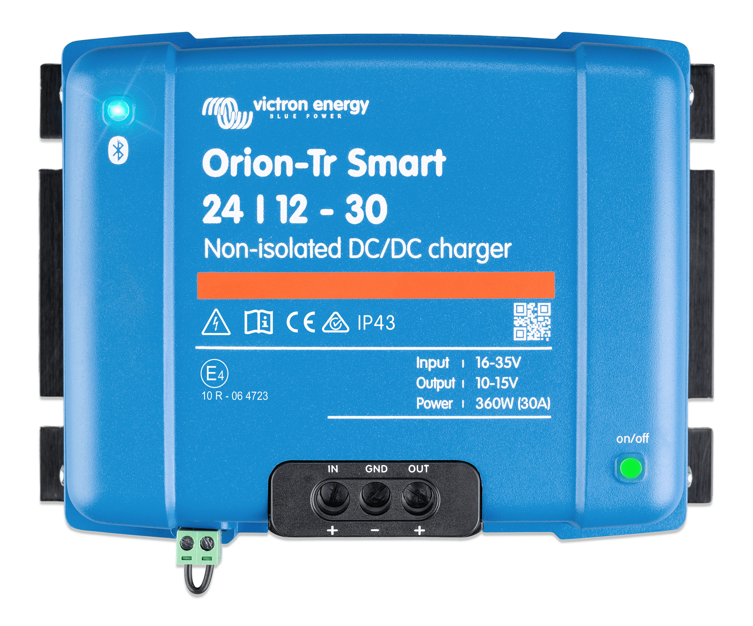
Updated 12v Systems (incomplete)
Start/Stop
Relays
DC/DC Charging
Cerbo GX
DC/DC Charging
300A each
1,200A Total
300A
keyed
AC/Primary Systems
AC Secondary
Systems
House
Existing - no change
HVAC, Washer, Outlets to run from the Inverter
Water Heater, GenSet only
Engine
Coupling
Windlass
MaxiFuse
Block
MaxiFuse
Block
Winch (Port)
HVAC Water Pump Starboard
Winch (Starboard)
HVAC Water Pump Port/Saloon
HVAC Port
HVAC Saloon
HVAC Starboard
DC/DC Charging
Water Maker
Fresh Water
Fuel (Port)
Fuel (Starboard)

Slide 18
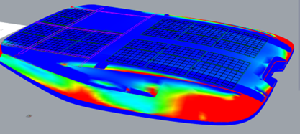
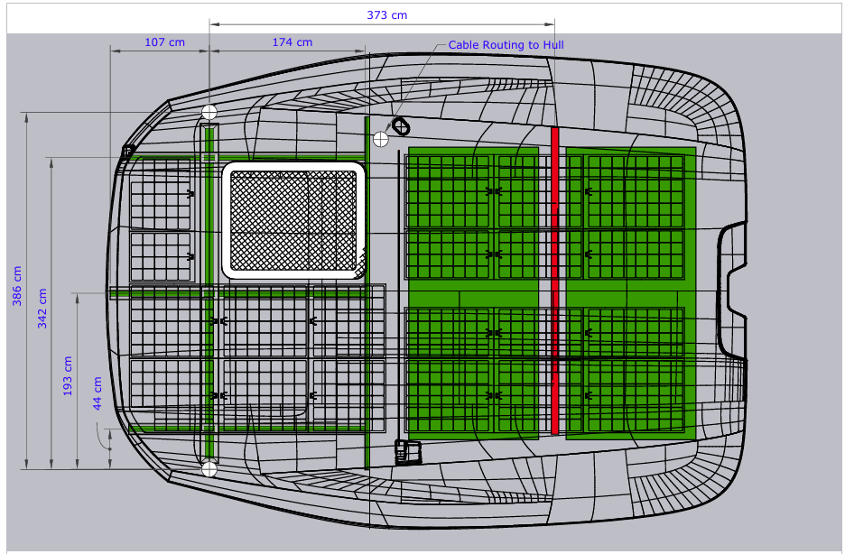
Solar Layout: Sobian SR Series, Textured, All Black

Slide 19
